Slide 1
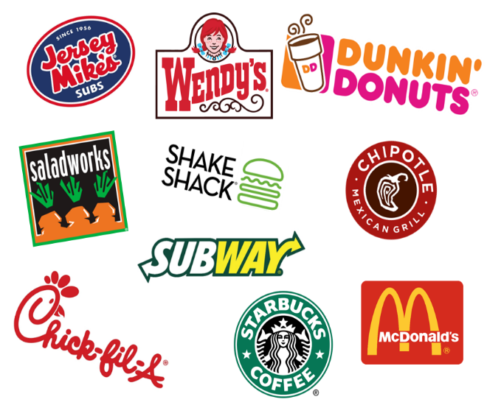
An Integer Programming Application: Meal Plans using Fast Food Chains
Pawel Bogdanowicz, Grace Foster, Gavin McCullion,
Yuyu Qin, Allison Volke, Shiyao Yuan

Slide 2
Agenda
I. Introduction & Problem Statement
II. Business Model and Data
III. Mathematical Model
IV. Implementation
V. Conclusion and Discussion

Slide 3
Introduction & Problem Statement
Goal:
Optimize a diet consisting entirely of fast food and fast-casual restaurants near University City for Drexel University students in lieu of Campus dining or cooking.
Benefit:
Target cost effective model
Ensure nutritional goals are met
Adaptive model (time frame, food, restaurants)
Methodology:
Mixed Integer Linear Programming
Minimum Cost Objective Function
Targeted Personal Constraints:
Individual Health Goals
Exercise Habits
Physical Characteristics:
Height
Weight
Gender
Notes:
Intro: Allison

Slide 4
Practical Objective & Constraints
Objective Function
minimize:
Total Cost =
∑ [Cost per Item of Food]*[Quantity of Item Consumed]
Constraint Type
Description:
Nutritional Requirements
Required values of Calories, Protein, Fat, Carbs, Sodium, Fiber, Sugar, & Cholesterol
Balanced Diet
Must eat breakfast, lunch and dinner every day
Variety
Cannot repeat restaurants more than once in a day, or two days in a row
Notes:
Model Theory: Grace

Slide 5










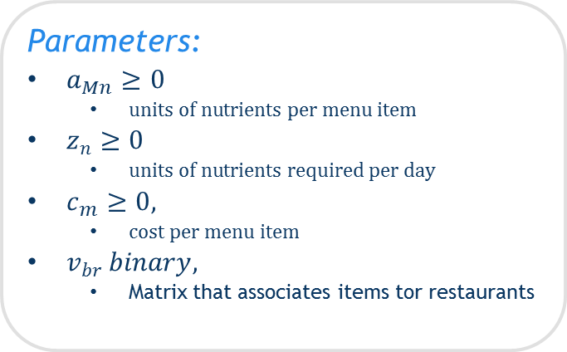
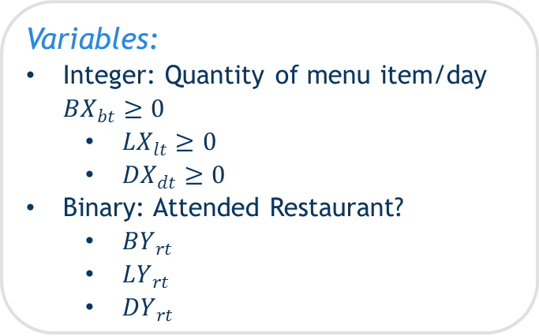
Data, Parameters, & Variables
Data:
Collected from 11 restaurants initially, 1 excluded
For each menu item:
Classify as Breakfast or Lunch/Dinner
Price
Nutrients
Sets:
B: A set of Breakfast Foods
L: A set of lunch Foods
D: a set of dinner foods
N: a set of nutrients
T: a set of days you are building meal plans for
R: A set of Restaurants
M: B, L or D
Parameters:
$a_{Mn}≥0$
$units of nutrients per menu item$
$z_{n}≥0$
$units of nutrients required per day$
$c_{m}≥0,$
$cost per menu item$
$v_{br} binary,$
Matrix that associates items tor restaurants
Variables:
Integer: Quantity of menu item/day ${BX}_{bt}≥0$
${LX}_{lt}≥0$
${DX}_{dt}≥0$
Binary: Attended Restaurant?
${BY}_{rt}$
${LY}_{rt}$
${DY}_{rt}$
Notes:
Data Collection: Yuyu

Slide 6
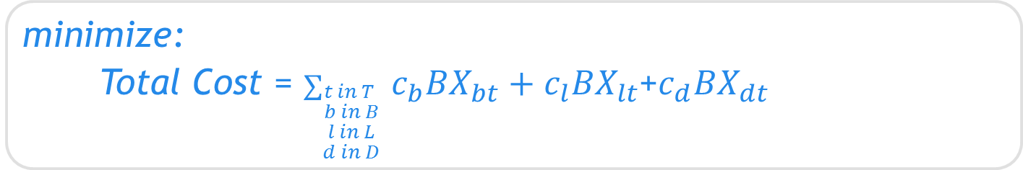



Mixed Integer Programming Model
Objective Function
minimize:
Total Cost = $∑_{\begin{aligned}t in T \\ b in B \\ l in L \\ d in D\end{aligned}}$ $c_{b}{BX}_{bt}+c_{l}{BX}_{lt}$+$c_{d}{BX}_{dt}$
Constraint Type
Description:
Nutritional Requirements
$a_{bn}{BX}_{bt}+a_{ln}{BX}_{lt}$+$a_{dn}{BX}_{dt}≥z_{n} for each n in N and t in T$
Balanced Diet
$∑_{b in B}$ ${BX}_{bt}≥1 for each t in T$
$∑_{l in L}$ ${LX}_{lt}≥1 for each t in T$
$∑_{d in D}$ ${LX}_{dt}≥1 for each t in T$
Variety
$$∑_{r in R}{BY}_{rt}≤1 for each t in T$$
$$∑_{r in R}{LY}_{rt}≤1 for each t in T$$
$$∑_{r in R}{DY}_{rt}≤1 for each t in T$$
Notes:
Model: Shiyao

Slide 7
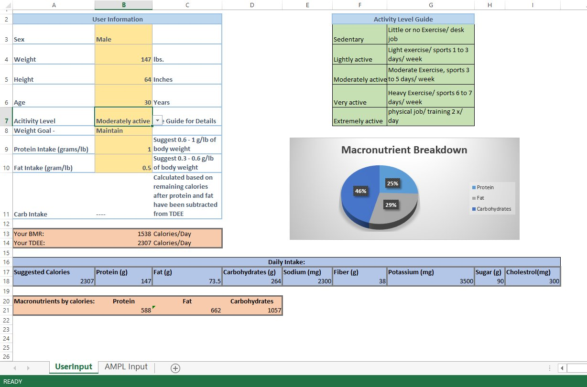
Model Implementation
Decision Support System: Nutritional Requirements
Notes:
Decision Support System: Gavin

Slide 8
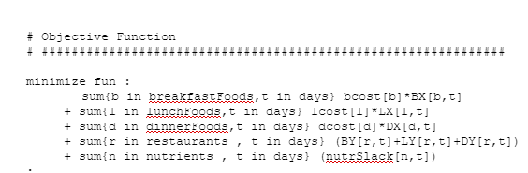
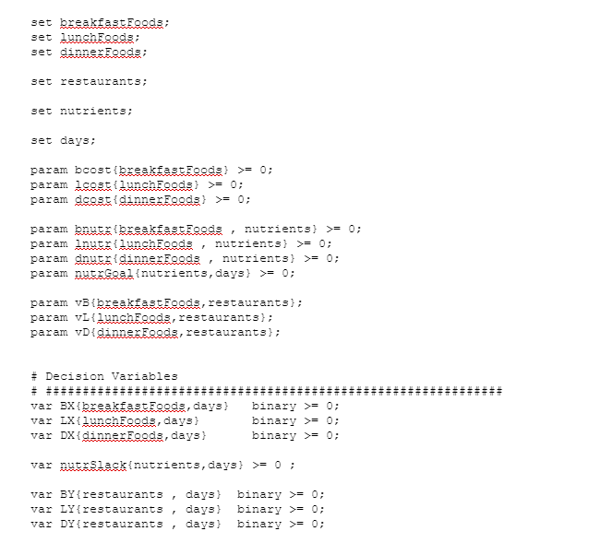
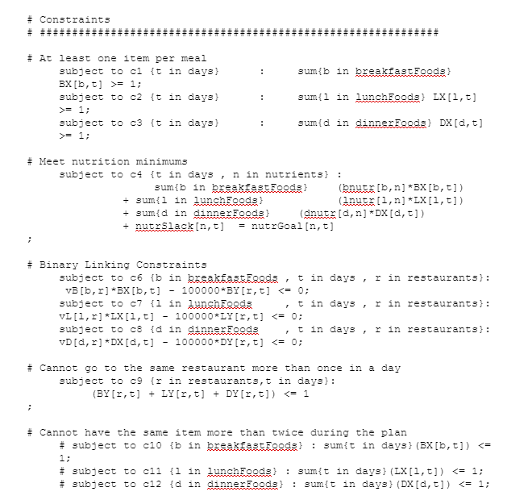
Model Implementation
Implement using AMPL
Notes:
Model and Results: Pawel

Slide 9
Conclusion and Discussion
Sample Meal Plans:
Restaurant | Item | Price | Calories | Protein | Fat | Carbs | Sodium | Fiber | Sugar | Chol.
Breakfast
Starbucks | Pumpkin Cookie | 2.25 | 330 | 4 | 19 | 37 | 125 | 0 | 18 | 30
Starbucks | Oatmeal with Fresh Blueberries | 3.45 | 220 | 5 | 2.5 | 43 | 125 | 5 | 13 | 0
Starbucks | Oatmeal with Fresh Blueberries | 3.45 | 220 | 5 | 2.5 | 43 | 125 | 5 | 13 | 0
Starbucks | Oatmeal with Fresh Blueberries | 3.45 | 220 | 5 | 2.5 | 43 | 125 | 5 | 13 | 0
Lunch
McDonald's | Side Salad | 1 | 20 | 1 | 0 | 4 | 10 | 1 | 2 | 0
McDonald's | Side Salad | 1 | 20 | 1 | 0 | 4 | 10 | 1 | 2 | 0
McDonald's | Chicken McNuggets 4 Piece w/ Marinara Sauce | 1.99 | 205 | 9 | 12 | 14 | 435 | 1 | 2 | 25
Dinner
Subway | 6" Oven Roasted Chicken | 4.25 | 320 | 23 | 5 | 47 | 610 | 5 | 8 | 40
Subway | 6" Oven Roasted Chicken | 4.25 | 320 | 23 | 5 | 47 | 610 | 5 | 8 | 40
Total |  | 25.09 | 1875 | 76 | 48.5 | 282 | 2175 | 28 | 79 | 135
Goals |  |  | 2400 | 100 | 50 | 350 | 2200 | 30 | 80 | 250
Difference |  |  | 525 | 24 | 1.5 | 68 | 25 | 2 | 1 | 115
Discussion
Future Considerations:
More Restaurants/Availability
Personal preferences
Other dietary restrictions (vegetarian)
Learnings:
Importance of model efficiency and solvers as well as data size\
Notes:
Model and Results: Pawel

